Slide 1

Project Giga Bharat – Tesla India Launch Strategy
Created by: Akshat Sharma
Last Updated: 19 Sept 2025

Slide 2

Business Objective
Simulate Tesla's strategic entry into the Indian EV market using Power BI. Identify the optimal car model, launch cities, and market conditions based on multi-dimensional data analysis.
This comprehensive analysis will guide Tesla's market entry strategy by examining infrastructure readiness, economic capacity, policy support, and consumer demand across India's diverse metropolitan markets.

Slide 3

Key Strategic Questions
1
2
Which car should Tesla launch?
Total EV sales in India
Based on segment-wise EV sales, identify the most viable Tesla model for Indian market conditions and consumer preferences.
Understand overall market size and growth potential across all vehicle segments to assess market opportunity.
3
4
Which cities have the highest charging stations?
Which cities have the highest GDP?
Infrastructure readiness assessment for successful Tesla launch and customer satisfaction.
Economic capacity analysis for premium EV adoption and purchasing power evaluation.
5
Which states offer the highest EV subsidies?
Policy support evaluation for affordability and government incentive optimization.

Slide 4












Data Sources Used
EV Segment Sales
Charging Infrastructure
Government transport ministry reports providing comprehensive vehicle registration and sales data
State EV dashboards tracking charging station deployment and accessibility metrics
Economic Data
Policy Framework
RBI and state economic surveys providing GDP and purchasing power indicators
FAME-II and state EV policies detailing subsidy structures and incentive programs
Consumer Interest
Product Specifications
Google Trends data revealing search patterns and brand awareness levels
Tesla official site providing detailed model specifications and pricing information

Slide 5





Tools & Technologies
Power BI
Advanced data modeling, interactive dashboard design, and comprehensive visualization capabilities for strategic insights
Google Trends
Search interest analysis and consumer behavior tracking to identify demand patterns
Excel
Data cleaning, transformation, and preliminary analysis to ensure data quality and consistency
AI Assistants
Workflow orchestration, documentation automation, and analytical support throughout the project

Slide 6
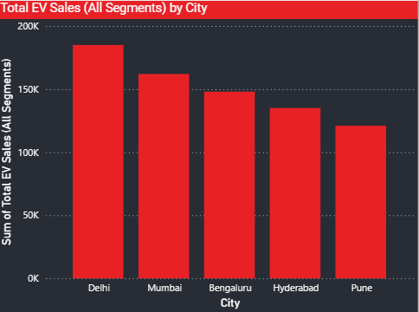
EV Market Size
India's total EV sales across all segments show strong upward momentum. This validates the timing for Tesla's entry into the market.
1 M
45%
8.2%
Total EV Sales
Annual Growth
Market Share
Cumulative electric vehicle sales across all segments in India
Year-over-year growth rate demonstrating market expansion
EV penetration in total vehicle sales, indicating growing adoption
The robust growth trajectory and increasing consumer acceptance create an optimal environment for Tesla's premium EV offerings in the Indian market.

Slide 7
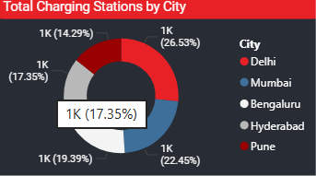
Infrastructure Readiness
Cities with Highest Charging Stations
1
Delhi
Leading charging infrastructure with comprehensive network coverage
2
Mumbai
Extensive charging network supporting high-density urban mobility
3
Pune
Rapidly expanding infrastructure with strategic location advantages
4
Bengaluru
Tech hub with progressive EV infrastructure development
5
Hyderabad
Growing charging network with government policy support
These cities are ideal for initial rollout due to their robust charging infrastructure, ensuring customer confidence and operational success.

Slide 8
Economic Capacity & Policy Support
Highest GDP Cities
Highest EV Subsidies
Cities with strongest economic capacity:
States offering maximum policy support:
Mumbai
Delhi
Financial capital with highest purchasing power
Comprehensive subsidy structure and road tax exemptions
Delhi
Maharashtra
National capital region with strong economic base
Progressive EV policy with attractive incentives
Bengaluru
Telangana
IT hub with affluent consumer segment
Forward-thinking EV adoption support programs
Hyderabad
Karnataka
Emerging tech center with growing wealth
Innovation-friendly policies supporting EV transition
Pune
Industrial center with strong middle class
These incentives significantly reduce effective cost and boost adoption, creating favorable conditions for Tesla's premium positioning.

Slide 9
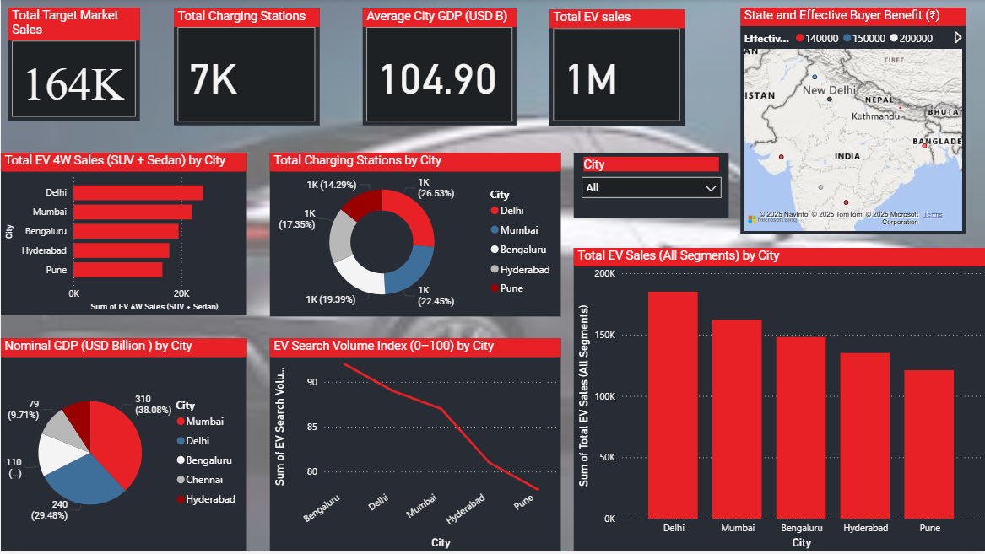





Dashboard Summary
The Power BI dashboard provides a comprehensive visualization of Tesla's India launch strategy, integrating multiple data dimensions for strategic decision-making.
EV Market Segmentation
Detailed analysis of vehicle categories, sales trends, and consumer preferences across different market segments
Infrastructure & Policy Readiness
Comprehensive mapping of charging infrastructure, government subsidies, and regulatory support across states
City-Level Demand Signals
Google search trends, economic indicators, and consumer behavior patterns for targeted market entry
Strategic Rollout Recommendations
Data-driven recommendations for optimal model selection, launch cities, and market entry timeline
Key Insight: Delhi, Mumbai, Bengaluru, Hyderabad, and Pune emerge as the optimal launch cities, combining strong infrastructure, economic capacity, policy support, and consumer demand for Tesla's India entry strategy.

Slide 10

Recommended Tesla Models for India
Based on segment-wise EV sales and premium adoption trends, Model 3 and Model Y are the most viable options for Tesla's India launch.
Model 3
Aligns perfectly with mid-to-premium sedan demand in Indian metropolitan markets, offering the ideal balance of luxury and accessibility
Model Y
Fits the growing SUV preference in metro cities, capitalizing on India's shift toward larger, more versatile vehicles
These models balance affordability, brand appeal, and infrastructure compatibility, making them ideal for India's evolving EV landscape.

